Slide 1
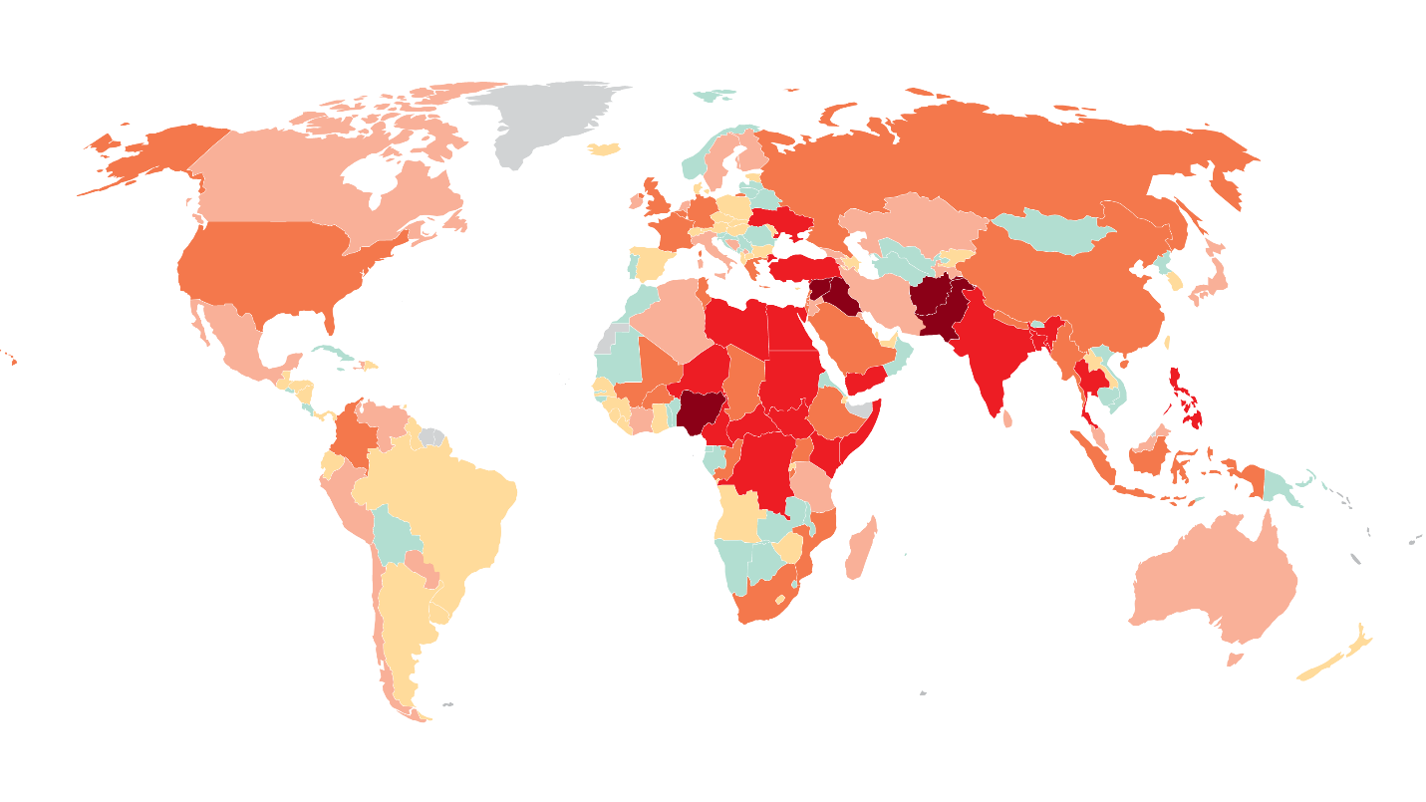
Global Terrorism
Presented By:
Greeshma Srinivasa Raju
Raghavi Vijayakumar
Kavitha Sundar Ram
Prof. Naveed Saleem
School of Business
University of Houston – Clear Lake

Slide 2
Content
An overview
A brief discussion on the project data set
Data cleansing
Description of the Dimension and Fact tables
ER Diagram of the relationships
Reports generated
Conclusions of the project analysis

Slide 3
Overview
Global Terrorism dataset had records of terrorist attacks that happened all over the world between the years 1970-2015.
Given the data, we could calculate the tremendous impact it would leave the places it affected.
Analysis on when the occurrences of these attacks were frequent were performed.
Further analysis were concentrated on the type of attack on the type of targets that were successful.
Countries such as Afghanistan, Indonesia, India, Iraq that have been severely impacted by terrorism have been analyzed on what time of the year they were attacked the most.

Slide 4
Project data set
The Global Terrorism Database (GTD) is an open-source database including information on terrorist attacks around the world from 1970 through 2015.
It includes systematic data on domestic as well as international terrorist incidents that have occurred during this time period .
This data covers around 180,000 attacks around the world.
For each event, a wide range of information is available:
The date and location of the incident
Weapons used
Nature of the target
Number of casualties and the group or individual responsible

Slide 5
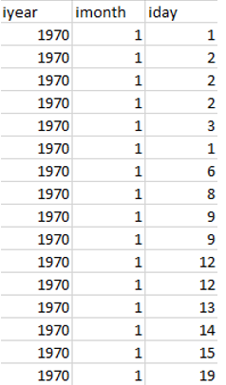
Data Cleansing
Data that were repeated, missing, inconsistent and irrelevant to the analysis being performed were removed/corrected.
Some data even consists of null values that were removed.
Data cleansing was necessary to achieve clean and accurate data to work with. This is where corrupt or inaccurate records were identified and replaced.
For Example: Repetitive data

Slide 6
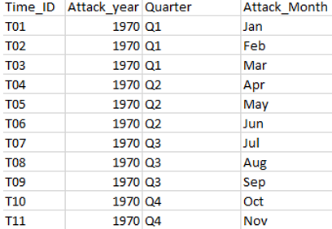
Data Cleansing(contd)
Cleaned data: Time_ID is the primary key which is defined in Attack_Time_Details to eliminate inconsistent data.

Slide 7
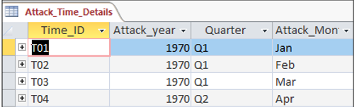
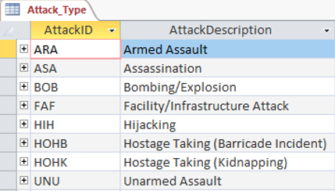
Description of the Dimension tables
The dimension tables of Global Terrorism statistic are:
Attack Time Details:
Time_ID(Unique ID), Attack_year, Quarter, Attack_month
Attack Type:
Attack_ID (Unique ID), Attack_Description

Slide 8
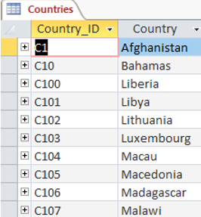
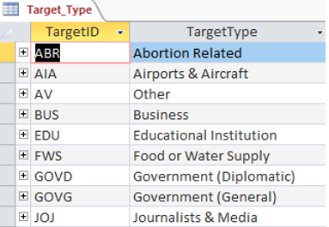
Description of the Dimension tables(Contd)
Countries:
Country_ID(Unique ID), Country
Target Type:
Target_ID(Unique ID), Target_Type

Slide 9
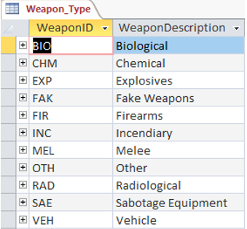
Description of the Dimension tables(Contd)
Weapon Type:
Weapon_ID(Unique ID), Weapon_Type

Slide 10
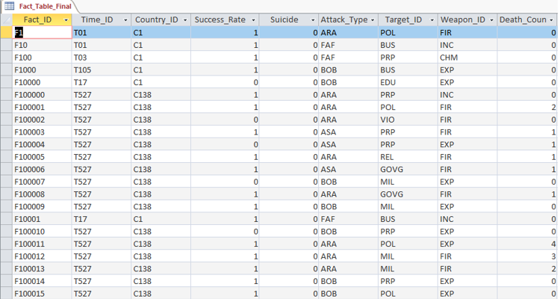
Description of the Fact table
A fact table consists of the measurements, metrics or facts of a business process.
The facts table is all about:
Success Rate – It is nothing but success of a terrorist strike.
Suicide – If it is 1 = “yes”, the incident was a suicide attack. If it is 0 = “No”, there is no indication that the incident was a suicide attack.
Death Count – The number of total confirmed fatalities for the incident.

Slide 11
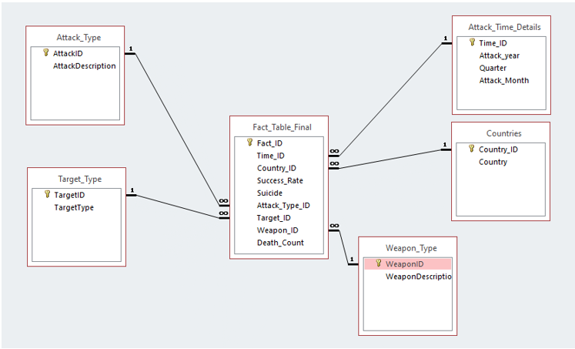
ER Diagram of the relationships

Slide 12
Report
Top 5 Countries with Highest success rate in terrorist attacks.
Countries with maximum Success Rate in a particular Attack Type
Attacks that were successful over different years and maximum attack type in a maximum attacked year.
Most used weapon on Major Targets
Attacks with time frame.
Suicide Attacks on Top targets

Slide 13
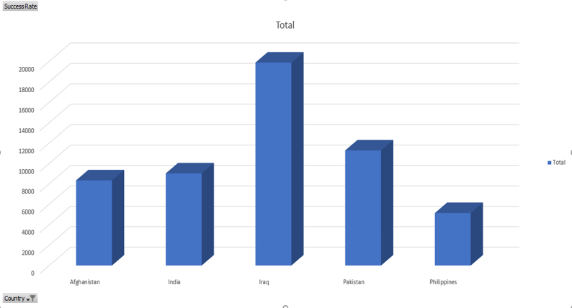
1. Top 5 Countries with Highest success rate in terrorist attacks

Slide 14
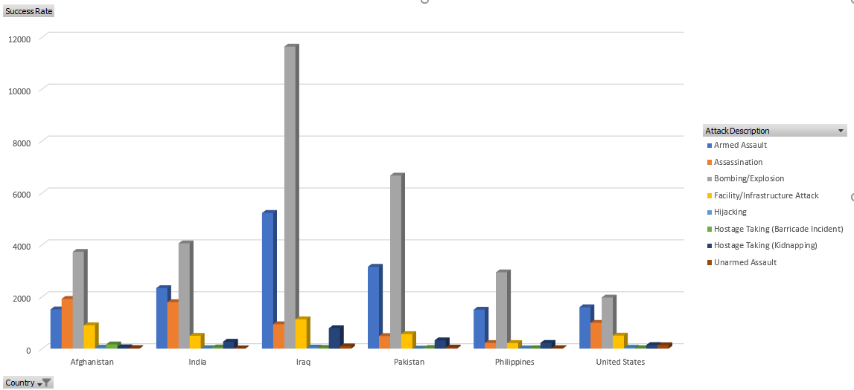
2. Countries with maximum success rate of attacks in a particular Attack Type
The country with the highest success rate of attacks was Iraq with Bombing being the most successful attack Type

Slide 15
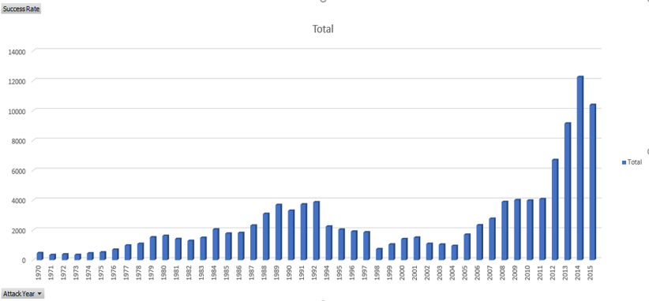
3. Attacks that were Successful over different Years and Maximum attack type in a maximum attacked year.
3a. Years with highest attacks during the 70s,80s,90s,2000s

Slide 16
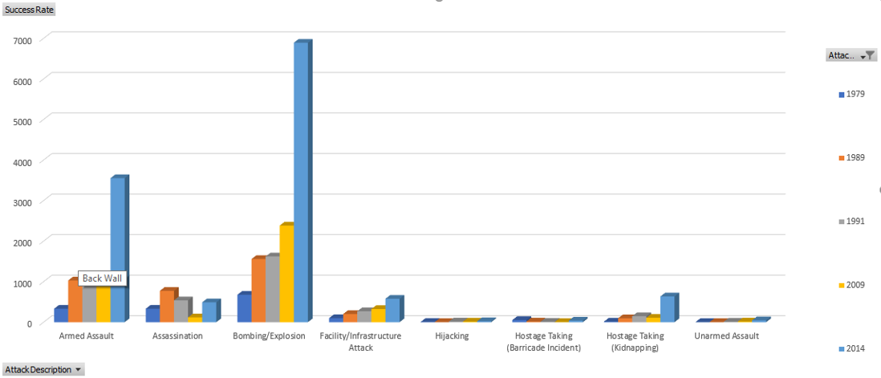
3b. Successful Attack type during the top 5 highly attacked years

Slide 17
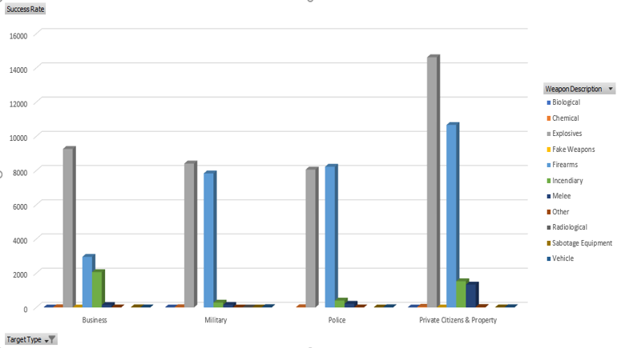
4. Most used weapon on Major Targets
Targets were mostly attacked with explosives
Top 3 used weapons were Bombs, Firearms and Incendiary

Slide 18
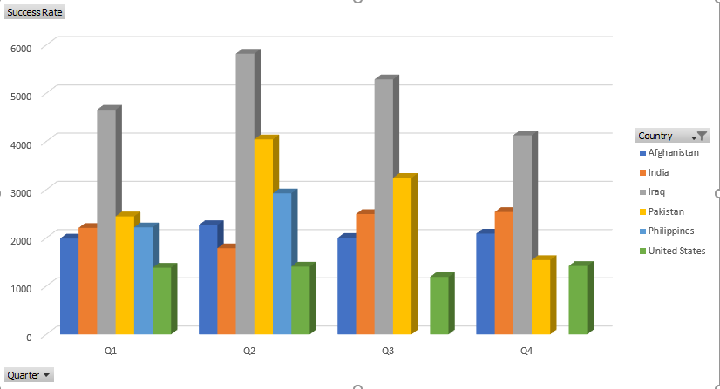
5. Attacks with time frame
Before doing the analysis we predicted that the Christmas/New years would be the highest time for a terror attack and began our analysis.
Turned out that the prediction was wrong. The attacks were prominent around the months of April, May, June (Quarter 2).

Slide 19
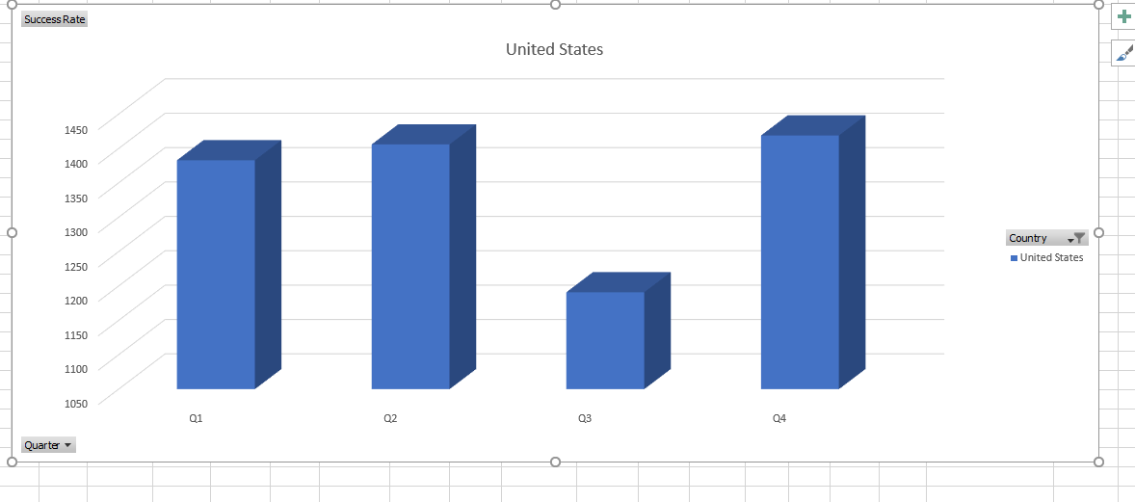
Time Frame for USA

Slide 20
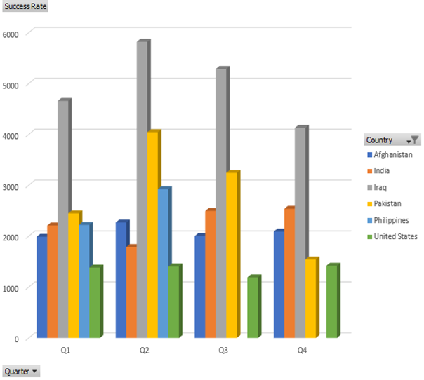
6. Success rate and death counts over different quarters in a year
6a. Success rate was maximum in Quarter 2(April, May, June)

Slide 21
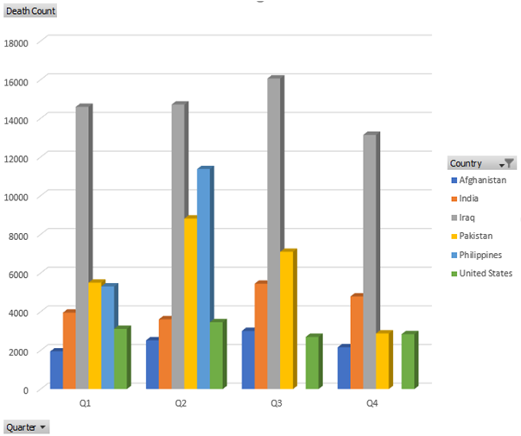
6b. Death Count was maximum in Quarter 3(July, August, September)

Slide 22
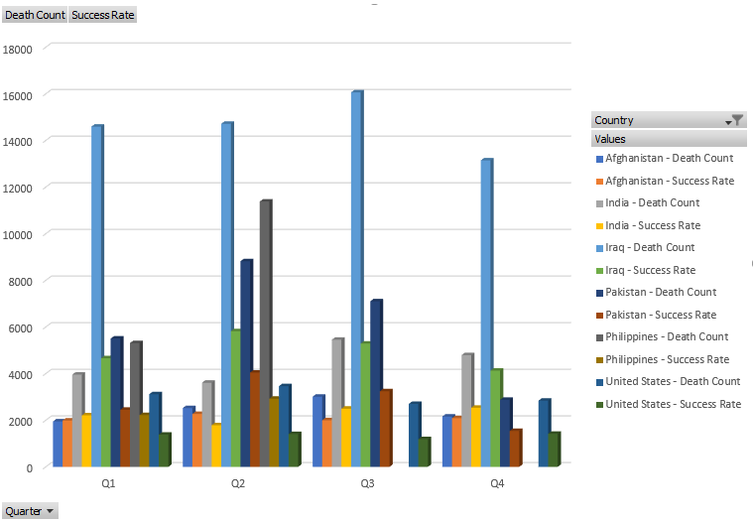
Cumulative chart of death counts and success rate
6c. Top 3 Countries with Maximum Success rates and death counts
are Iraq, Pakistan and India

Slide 23
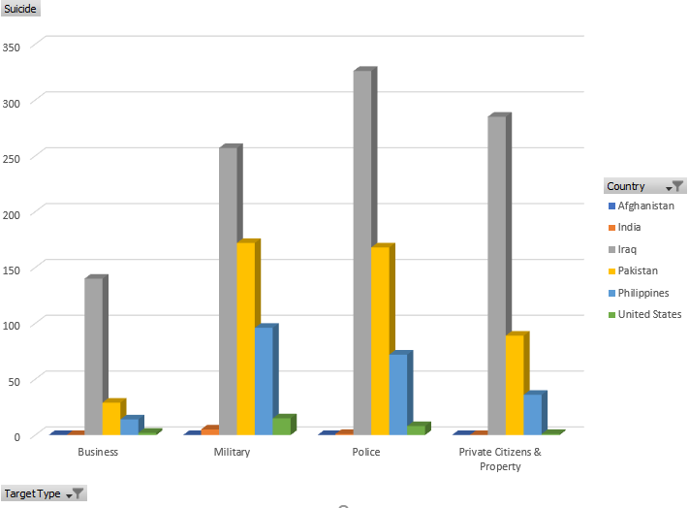
7. Suicide Attacks on Top targets
Suicide Attacks were Maximum on Police

Slide 24
Conclusion
Data showed that the bombing attacks were the highest in the years 1979,1989,1991,2009 and 2014 globally.
Top 5 severely attacked countries were Iraq, Afghanistan , Pakistan, India , Indonesia and Philippines in order.
Bombing/Explosions were the most used weapon in terrorist attacks.
Private property, citizens and military were the major targets in the attacks.
The country with the highest death count due to these attacks is Iraq.
Majority of the attacks happened in the months of April, May and June from the statistics we analyzed.

Slide 25
Thank You

